Slide 1
ACID PEPTIC DISORDER
DR.T.AJAYAN
PROF. & H.O.D.
PM

Slide 2
Definition
A circumscribed ulceration of the gastrointestinal mucosa occurring in areas exposed to acid and pepsin and most often caused by Helicobacter pylori infection.
(Uphold & Graham, 2003)

Slide 3
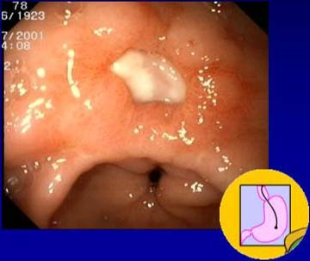
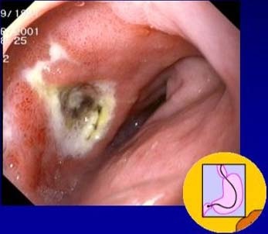
Peptic Ulcers: Gastric & Dudodenal

Slide 4
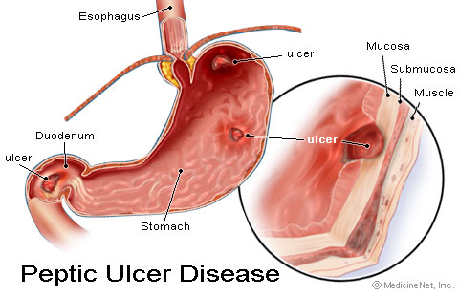
Comparing Duodenal and Gastric Ulcers

Slide 5
Duodenal Ulcers
duodenal sites are 4x as common as gastric sites
most common in middle age
peak 30-50 years
Male to female ratio—4:1
Genetic link: 3x more common in 1st degree relatives
more common in patients with blood group O
associated with increased serum pepsinogen
H. pylori infection common
up to 95%
smoking is twice as common
Notes:
Socioeconomic status may play into risk factors as well.

Slide 6
Gastric Ulcers
common in late middle age
incidence increases with age
Male to female ratio—2:1
More common in patients with blood group A
Use of NSAIDs - associated with a three- to four-fold increase in risk of gastric ulcer
Less related to H. pylori than duodenal ulcers – about 80%
10 - 20% of patients with a gastric ulcer have a concomitant duodenal ulcer

Slide 7
Etiology
A peptic ulcer is a mucosal break, 3 mm or greater, that can involve the stomach or duodenum.
The most important contributing factors are H pylori, NSAIDs, acid, and pepsin.
Additional aggressive factors include smoking, ethanol, bile acids, aspirin, steroids, and stress.
Important protective factors are mucus, bicarbonate, mucosal blood flow, prostaglandins, hydrophobic layer, and epithelial renewal.
Increased risk when older than 50 d/t decrease protection
When an imbalance occurs, PUD might develop.
Notes:
In both types of peptic ulceration, gastric and duodenal, there is an imbalance between secretion and neutralization of secreted acid.
In duodenal ulcers there is an oversecretion of acid whilst in gastric ulcers there is an impairment of mucosal protection

Slide 8
Subjective Data
Pain—”gnawing”, “aching”, or “burning”
Duodenal ulcers: occurs 1-3 hours after a meal and may awaken patient from sleep. Pain is relieved by food, antacids, or vomiting.
Gastric ulcers: food may exacerbate the pain while vomiting relieves it.
Nausea, vomiting, belching, dyspepsia, bloating, chest discomfort, anorexia, hematemesis, &/or melena may also occur.
nausea, vomiting, & weight loss more common with Gastric ulcers

Slide 9
Objective Data
Epigastric tenderness
Guaic-positive stool resulting from occult blood loss
Succussion splash resulting from scaring or edema due to partial or complete gastric outlet obstruction
A succussion splash describes the sound obtained by shaking an individual who has free fluid and air or gas in a hollow organ or body cavity.
Usually elicited to confirm intestinal or pyloric obstruction.
Done by gently shaking the abdomen by holding either side of the pelvis. A positive test occurs when a splashing noise is heard, either with or without a stethoscope. It is not valid if the pt has eaten or drunk fluid within the last three hours.

Slide 10
Differential Diagnosis
Neoplasm of the stomach
Pancreatitis
Pancreatic cancer
Diverticulitis
Nonulcer dyspepsia (also called functional dyspepsia)
Cholecystitis
Gastritis
GERD
MI—not to be missed if having chest pain

Slide 11
Diagnostic Plan
Stool for fecal occult blood
Labs: CBC (R/O bleeding), liver function test, amylase, and lipase.
H. Pylori can be diagnosed by urea breath test, blood test, stool antigen assays, & rapid urease test on a biopsy sample.
Upper GI Endoscopy: Any pt >50 yo with new onset of symptoms or those with alarm markings including anemia, weight loss, or GI bleeding.
Preferred diagnostic test b/c its highly sensitive for dx of ulcers and allows for biopsy to rule out malignancy and rapid urease tests for testing for H. Pylori.
Notes:
Rapid urease tests are considered the endoscopic diagnostic test of choice. The presence of H pylori in gastric mucosal biopsy specimens is detected by testing for the bacterial product urease. Three kits (CLOtest, Hpfast, Pyloritek) are commercially available, each containing a combination of a urea substrate and a pH sensitive indicator. One or more gastric biopsy specimens are placed in the rapid urease test kit. If H pylori are present, bacterial urease converts urea to ammonia, which changes pH and produces a color change

Slide 12
Lifestyle Changes
Discontinue NSAIDs and use Acetaminophen for pain control if possible.
Acid suppression--Antacids
Smoking cessation
No dietary restrictions unless certain foods are associated with problems.
Alcohol in moderation
Men under 65: 2 drinks/day
Men over 65 and all women: 1 drink/day
Stress reduction

Slide 13
Prevention
Consider prophylactic therapy for the following patients:
Pts with NSAID-induced ulcers who require daily NSAID therapy
Pts older than 60 years
Pts with a history of PUD or a complication such as GI bleeding
Pts taking steroids or anticoagulants or patients with significant comorbid medical illnesses
Prophylactic regimens that have been shown to dramatically reduce the risk of NSAID-induced gastric and duodenal ulcers include the use of a prostaglandin analogue or a proton pump inhibitor.
Misoprostol (Cytotec) 100-200 mcg PO 4 times per day
Omeprazole (Prilosec) 20-40 mg PO every day
Lansoprazole (Prevacid) 15-30 mg PO every day

Slide 14
Complications
Perforation & Penetration—into pancreas, liver and retroperitoneal space
Peritonitis
Bowel obstruction, Gastric outflow obstruction, & Pyloric stenosis
Bleeding--occurs in 25% to 33% of cases and accounts for 25% of ulcer deaths.
Gastric CA

Slide 15
Surgery
People who do not respond to medication, or who develop complications:
Vagotomy - cutting the vagus nerve to interrupt messages sent from the brain to the stomach to reducing acid secretion.
Antrectomy - remove the lower part of the stomach (antrum), which produces a hormone that stimulates the stomach to secrete digestive juices. A vagotomy is usually done in conjunction with an antrectomy.
Pyloroplasty - the opening into the duodenum and small intestine (pylorus) are enlarged, enabling contents to pass more freely from the stomach. May be performed along with a vagotomy.

